Slide 1
Introduction to Artificial Intelligence
AI Ecosystem

Slide 2
Learning outcomes
Overview of AI
AI history
AI components
AI applications (use cases)
AI ethics, challenges and possible solution
AI future trends

Slide 3
AI Ecosystem
The AI ecosystem refers to the interconnected components that support the:
  development,
  deployment, and
  operation of AI technologies

Slide 4
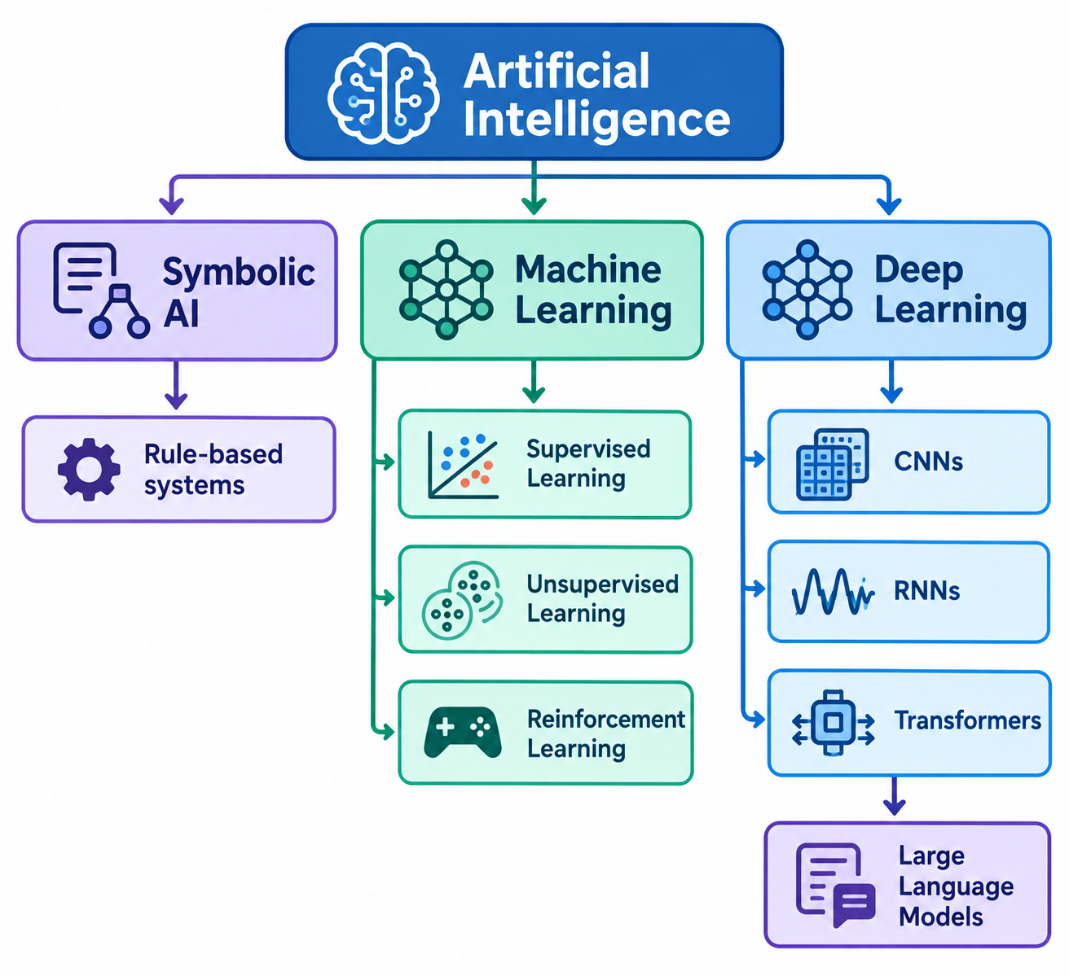
Artificial Intelligence Hierarchy
Source: Image generated using ChatGPT (OpenAI), accessed September 2026

Slide 5
Artificial Intelligence
Artificial intelligence is the name given to any computer system taught to mimic intelligent human behaviours, and it was coined by John McCarthy in 1955¹
We can also define artificial intelligence (AI) as computing systems that are able to engage in human-like processes such as learning, adapting, synthesizing, self-correction and use of data for complex processing tasks²
It refers to anything from programs taught how to play board games and translate languages, to complex systems that can have human sounding conversations, analyse the stock market or help to diagnose health conditions
¹ A to Z of AI available at https://atozofai.withgoogle.com/intl/en-GB/artificial-intelligence/
² Popenici, Stefan AD, and Sharon Kerr. "Exploring the impact of artificial intelligence on teaching and learning in higher education." Research and Practice in Technology Enhanced Learning 12.1 (2017): 22

Slide 6
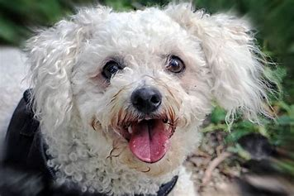
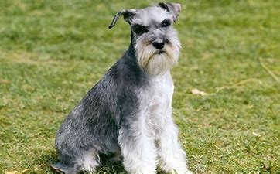
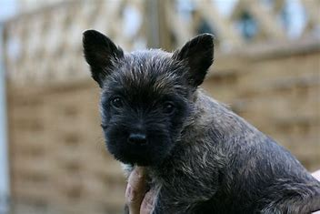

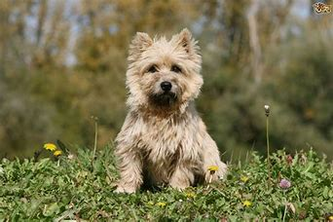

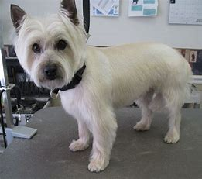
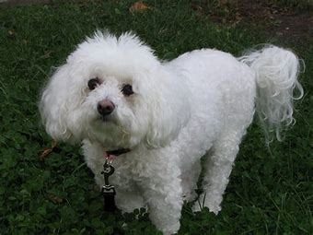

What is Intelligence?
Guess what is this?
How do you figure out they are all dogs?
Notes:
Example: Recognising Different Breeds of Dogs
Think about how humans recognise dogs:
If you see a poodle, a bulldog, or a German shepherd, you still know they are all dogs — even though they look very different.
You learned this by seeing many examples of dogs as you grew up, so your brain can generalise: “Even though this one is fluffy and that one is short, they are both dogs.”
Now imagine teaching a computer the same skill:
We show the computer thousands of pictures of different dog breeds, each labelled “dog.”
The AI looks for patterns — like the shape of the ears, the nose, or the way the body is structured.
Later, when it sees a new picture of a dog it hasn’t seen before, it can still say: “That’s a dog!” because it has learned the underlying features that make something a dog.
✨ Key Point for Students
Human intelligence: Learns from fewer examples, uses intuition.
Artificial intelligence: Learns from lots of data and finds patterns statistically.
So, when AI recognises a Great Dane and a Chihuahua as both being “dogs,” it’s performing a task that mimics human intelligence: recognising the concept of “dog” beyond just memorising pictures.

Slide 7


What is Intelligence?
Intelligence is the ability to learn, adapt, reason, and solve problems in new situations. (Adapted from Copeland, 2000)¹
Key Characteristics of Intelligence
  Learning: Acquiring knowledge from experience and applying it in new situations
  Reasoning: Drawing logical conclusions and making informed decisions
  Problem Solving: Identifying solutions to complex or unfamiliar challenges
  Perception: Understanding the environment through sensory information, such as recognising objects, faces, or speech
  Language Understanding: Interpreting and generating human language to communicate effectively
  Adaptability: Adjusting behaviour and decisions when circumstances change
¹Copeland, B.J. (1993) Artificial Intelligence: A Philosophical Introduction. Oxford: Blackwell Publishers.

Slide 8

Machine Learning
Machine learning is a term that is often confused with AI and it originates from the 1950s and was first defined by Arthur Lee Samuel in 1959
"The field of machine learning is concerned with the question of how to construct computer programs that automatically improve with experience“¹
Machine learning is the field where the goal is to build a computer program capable of learning patterns from data and improve its learning ability with more data and experience
¹ Machine Learning book by Tom Mitchell

Slide 9

Machine Learning vs Traditional Programming
  In traditional programming, if you wanted to teach a computer to draw a cat, you’d have to explain the drawing process in precise detail
  With machine learning, you feed an AI system thousands of cat sketches to analyse and let it look for patterns by itself
  Over time, it begins to recognise the features that make up a cat — such as pointy ears and whiskers — and develops a more flexible, clear understanding of what constitutes a cat sketch

Slide 10
Machine Learning
Supervised Learning
Supervised Learning is a type of machine learning that learns from labelled data and uses this knowledge to predict outcomes for new, unseen data
Building, training, scaling, and deploying an accurate supervised learning model typically requires significant time, high-quality data, and expertise from skilled data scientists and machine learning engineers
Unsupervised Learning
Unsupervised Learning is a machine learning technique that learns patterns from unlabelled data without predefined outcomes.
It allows the model to discover hidden structures, relationships, and trends on its own
Common applications include clustering and anomaly detection
Classification is a common supervised learning task, where the model predicts a predefined category or class
Reinforcement Learning
Reinforcement Learning (RL) is a type of machine learning in which an agent learns to make decisions by interacting with an environment and receiving rewards or penalties for its actions
Common applications include AlphaGo, Self-driving systems, Robotics, Game playing AI

Slide 11
Algorithms and Models
AI Algorithms: Machine learning algorithms are procedures that are implemented in code and are run on data (e.g., neural networks, decision trees, support vector machines)
AI Models: Machine learning models are output by algorithms and are comprised of model data and a prediction algorithm

Slide 12
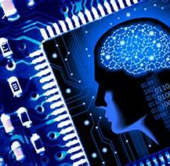
Neural Networks
Neural networks are computing systems with interconnected nodes that work much like neurons in the human brain
Using algorithms, they can recognise hidden patterns and correlations in raw data, cluster and classify it
Over time – continuously learn and improve

Slide 13
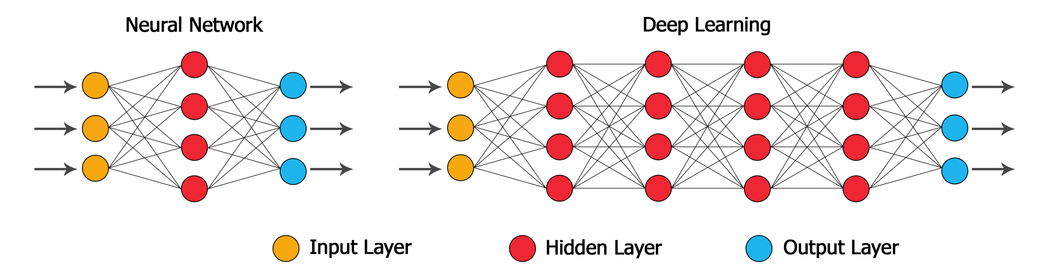
Deep Learning
Deep Learning or Hierarchical Learning is a subset of Machine Learning that can imitate the data processing function of the human brain and create similar patterns the brain used for decision making
Deep Learning systems learn from data representations – they can learn from labeled or unlabeled data

Slide 14
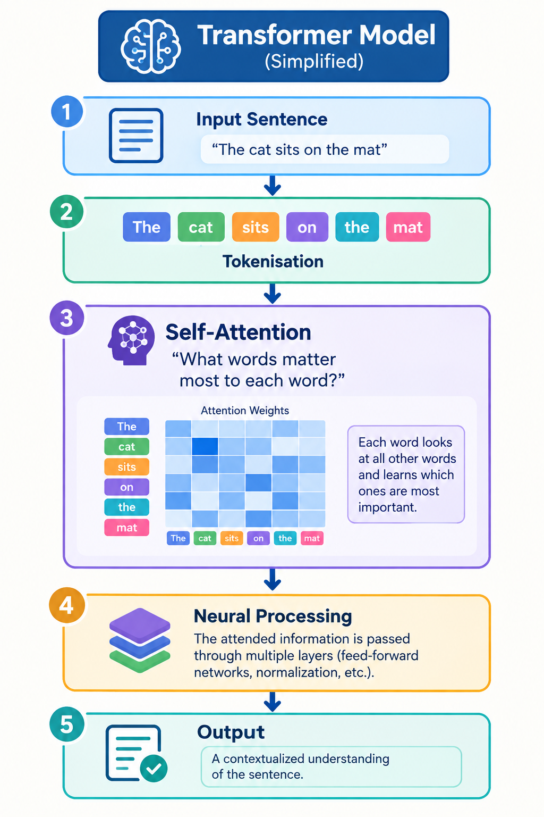
Transformer Models
Transformers are deep learning models that use a mechanism called attention to understand relationships between words, images, or other data, enabling them to process information in parallel and capture long-range context
Real-World Examples: ChatGPT (OpenAI), Microsoft Copilot, Gemini (Google), Claude (Anthropic), Llama (Meta)
Example:
  "The cat sat on the mat because ___ was tired“
  The attention mechanism helps the model understand that "it" refers to "the cat", not the mat

Slide 15
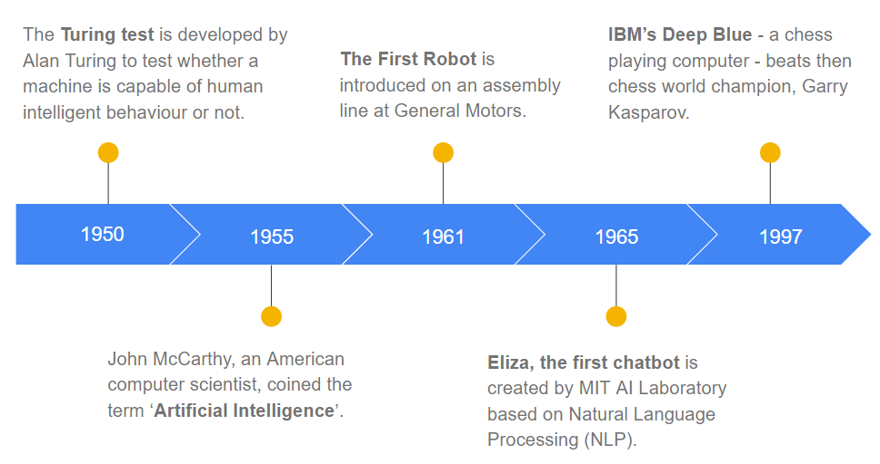
AI history

Slide 16
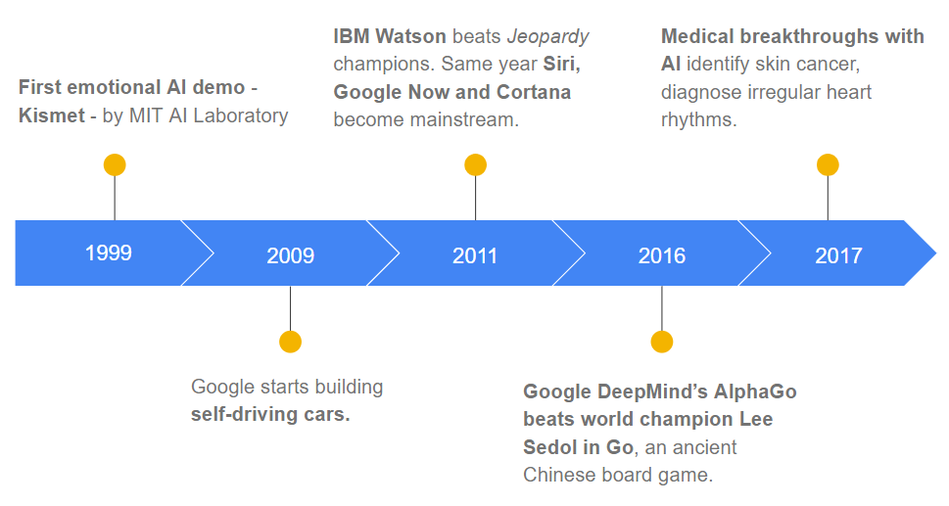
AI history

Slide 17

AI history
Deepfakes
The development of images or videos that show (usually) a public figure doing or saying something they never did or said
2018
2019
2020
Ethic Guidelines
The European union establishes guidelines for dealing with AI and a big move towards “Transparent AI”
Tiny AI
new algorithms to shrink existing deep-learning models without losing their capabilities
Let’s go beyond 2020 and explore some of the major highlights in Artificial Intelligence over the last five years

Slide 18
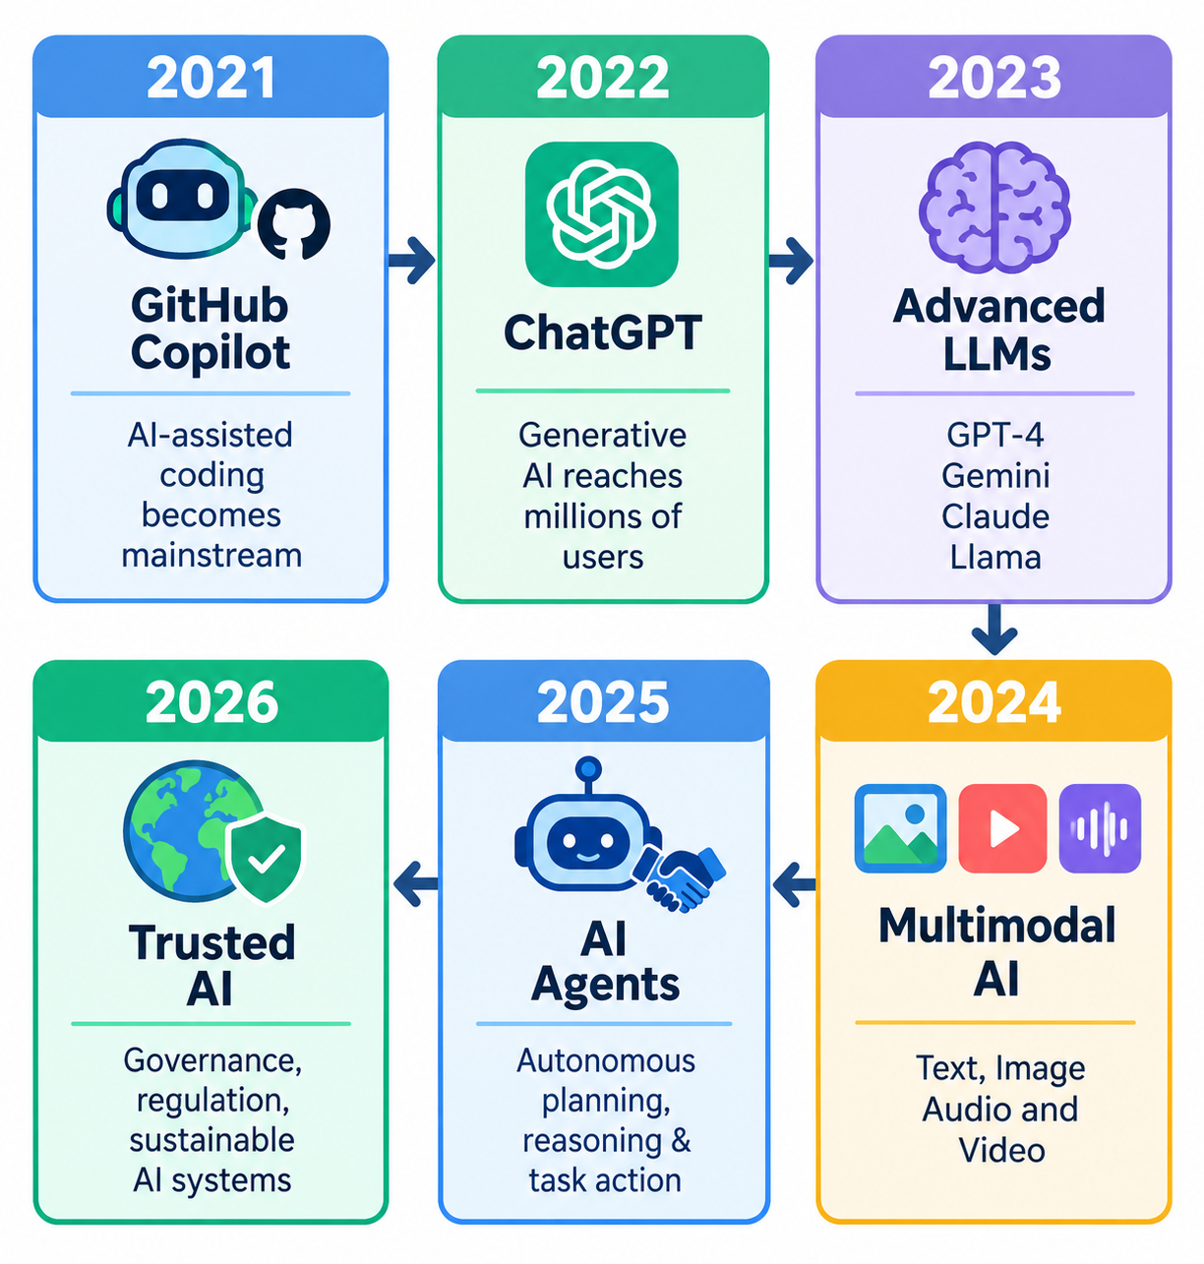
AI History: The Generative AI Era (2021-2026)
From AI assistants and large language models to multimodal systems and autonomous agents, AI has evolved from recognising patterns to generating content and performing complex tasks
Reflection Point
💡 Which of these milestones do you think has had the greatest impact on society so far, and why?

Slide 19
Generative AI
Generative AI creates new content:
Text (ChatGPT)
Images (DALL-E, Midjourney)
Video (Sora)
Audio (ElevenLabs)
Code (GitHub Copilot)
Discussion
How is Generative AI different from traditional predictive AI?

Slide 20
AI Agents
An AI agent can:
Observe
Reason
Plan
Act
Examples:
Microsoft Copilot
OpenAI Operators
AI customer service agents
Autonomous software testing
Question:
What kind of tasks would you delegate to an AI agent?

Slide 21
Demo 1: ChatGPT
Prompt:
Explain machine learning to a 10-year-old.
Then:
Explain machine learning to a PhD student.
Show adaptability.

Slide 22
Demo 2: Image Generation
Generate:
A cat flying an aeroplane over London
Ask:
Why is this difficult for traditional software?

Slide 23
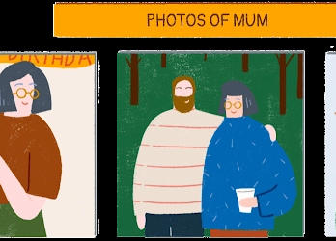
How Does AI Solve Problems?
Do you feel like AI knows what we need ?
Artificial Intelligence (AI) enables computers to perform tasks that normally require human intelligence, such as learning, reasoning, and decision-making
Many human problem-solving processes can be modelled and automated using AI techniques
Example: Online retailers use AI to analyse your browsing and purchasing behaviour and recommend products or personalised offers
AI systems learn user preferences from data using machine learning models, allowing predictions and recommendations to improve over time

Slide 24

How to perform AI
Machine learning is one way to achieve AI
Can you think of other ways to perform AI?
  Hardcode rules and mathematical intelligence (a rule-based system is used to store and manipulate knowledge to interpret information in a useful way)
Then | Now
Rule-Based AI: Expert systems If-then rules Tax software | Modern AI: ChatGPT Gemini Copilot Recommendation systems
  Would ChatGPT be possible with hand-written rules?

Slide 25
How Modern AI Works
Modern Generative AI systems learn patterns from large datasets, are trained into foundation models, adapted for specific tasks through fine-tuning, and respond to user prompts to generate useful outputs
Data
Training
Foundation Model
Fine-Tuning
Prompting
Output
Text, Images
Learn Pattern
GPT, Gemini
Domain Adaptation
User Instruction
Text, Images

Slide 26

Datasets
Datasets are large collections of digital information that are used to train AI
AI design teams have to carefully consider the data they choose to train their AI
They may build in parameters that help the system make sense of the information it’s given
Data collections can be very challenging to build and refine
It may consist of a few hundred audio samples or extensive maps covering the whole of the known solar system

Slide 27
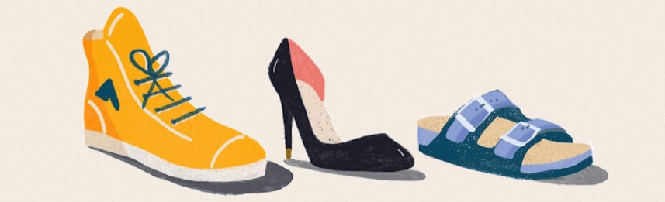
Bias in Datasets
“Typically, AI forms a bias when the data it’s given to learn from isn’t fully comprehensive and, therefore, starts leading it toward certain outcomes”
“Because data is an AI system’s only means of learning, it could end up reproducing any imbalances or biases found within the original information
What is happen if you were teaching AI to recognise shoes and only showed it images of sneakers?

Slide 28
Bias in Datasets
Bias makes it challenging to develop AI that works for everyone
No AI system is complex enough, nor dataset deep enough, to represent and understand humanity in all its diversity
A job-matching AI shortlisting candidates for CEO interviews might learn to favour men, simply because it was given successful CVs to learn from, and historically there was a societal bias towards male candidates

Slide 29
How to overcome dataset challenges
AI design teams often share datasets for the benefit of the wider scientific community, making it easier to collaborate and build on each other's research

Slide 30

AI Case Studies: Climate
AI is a powerful tool to tackle global climate challenges
People all over the world are using AI to help address the unprecedented crisis our planet is facing
  help to analyse collections of environmental information;
  track real-time changes in climate conditions, reduce inefficiencies, and identify vital opportunities for humanity to find solutions that could have a positive impact on our planet, faster;
  regulate the amount of energy wasted at home by turning off the heating and lights when we leave the house;
  help to combat drought by monitoring areas affected by desertification
  predict rising sea levels so effective action can be taken

Slide 31
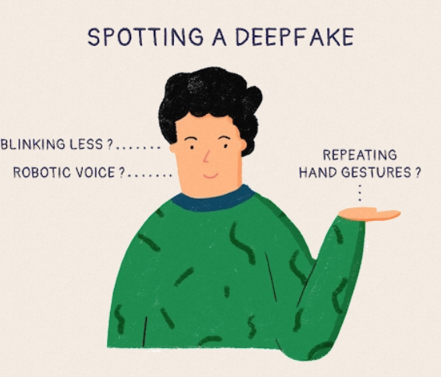

AI Case Studies: Fakes
Fake images, audio or video made using AI
AI has given rise to new ways for technologies to create hyper-realistic “deepfake” images, speech, music and video
Deepfakes work by studying existing real-world imagery or audio, mapping them in detail, then manipulating them to create works of fiction that are disconcertingly true to life
Fakes can be convincing but there are some revealing signs that distinguish them from reality
Let’s test it
Notes:
Demo 3: Deepfake Detection
Show:
Real image
AI image
Have students vote.
This creates engagement instantly.

Slide 32
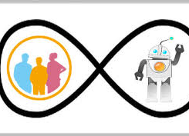
Human-in-the-loop
Human-in-the-Loop (HITL) is a person who helps train, test, and improve an AI system to make its results more accurate and reliable
AI can make mistakes and learn from incorrect patterns
A human can review AI outputs, correct errors, and guide the system towards better decisions
By combining human expertise with AI's processing power, we achieve more accurate and trustworthy outcomes
Example: A doctor reviews and validates an AI system's diagnosis before making a final clinical decision

Slide 33
AI Challenges and Risks
Hallucinations
Bias
Copyright concerns
Privacy
Job displacement
Deepfakes
Security threats
AI-generated misinformation
Should AI-generated assignments be allowed at university?

Slide 34
AI Around Us
Area | Example
Search | Google AI Overview
Productivity | Microsoft Copilot
Education | Khanmigo
Healthcare | Medical image diagnosis
Finance | Fraud detection
Retail | Recommendation systems
Manufacturing | Predictive maintenance
Transport | Autonomous vehicles

Slide 35
AI future trends
Many experts agree that the following are strong future AI trends:
  Multimodal AI (text, image, audio, video) — combining different data types to improve understanding and interaction
  Responsible / Explainable AI — transparency, fairness, accountability are increasingly important, especially in regulated fields (healthcare, finance etc.)
  Edge AI & Federated Learning — running AI models closer to users (on phones, sensors etc.), preserving privacy and reducing latency
  Industry-specific or vertical AI solutions — adapting AI to specific sectors (e.g. health diagnostics, manufacturing, education) rather than general-purpose tools
  Smaller, energy-efficient models — “lighter” models that consume less computation, are greener and more feasible to deploy at scale
Think about more examples of future AI trends

Slide 36

AI Is Everywhere!
Select a profession/industry
Identify one AI application
Describe:
  Benefits
  Risks
  Ethical concerns
  Future impact

